Slide 1
GK AquaTrust WaterPurifier
Pure Water • Healthy Life • Smart Income
Presented by: K.C. Kamal
Contact: 9599326310

Slide 2
About the Company
Provides advanced water purification systems
Mission: Safe drinking water for every home
Opportunity to earn through network marketing

Slide 3
Why Clean Water Matters
Many diseases are caused by unsafe water
Clean water improves health
Essential for every household

Slide 4
Our Product – Water Purifier
Copper Filtration + UV purification technology
Removes bacteria and viruses
Provides Alkaline water
Mineral balance system
No electricity consumption
Developed by BARC Mumbai
Approved by government of India.

Slide 5
Product Benefits
Safe drinking water
Better taste
Protects family health
Affordable and durable

Slide 6
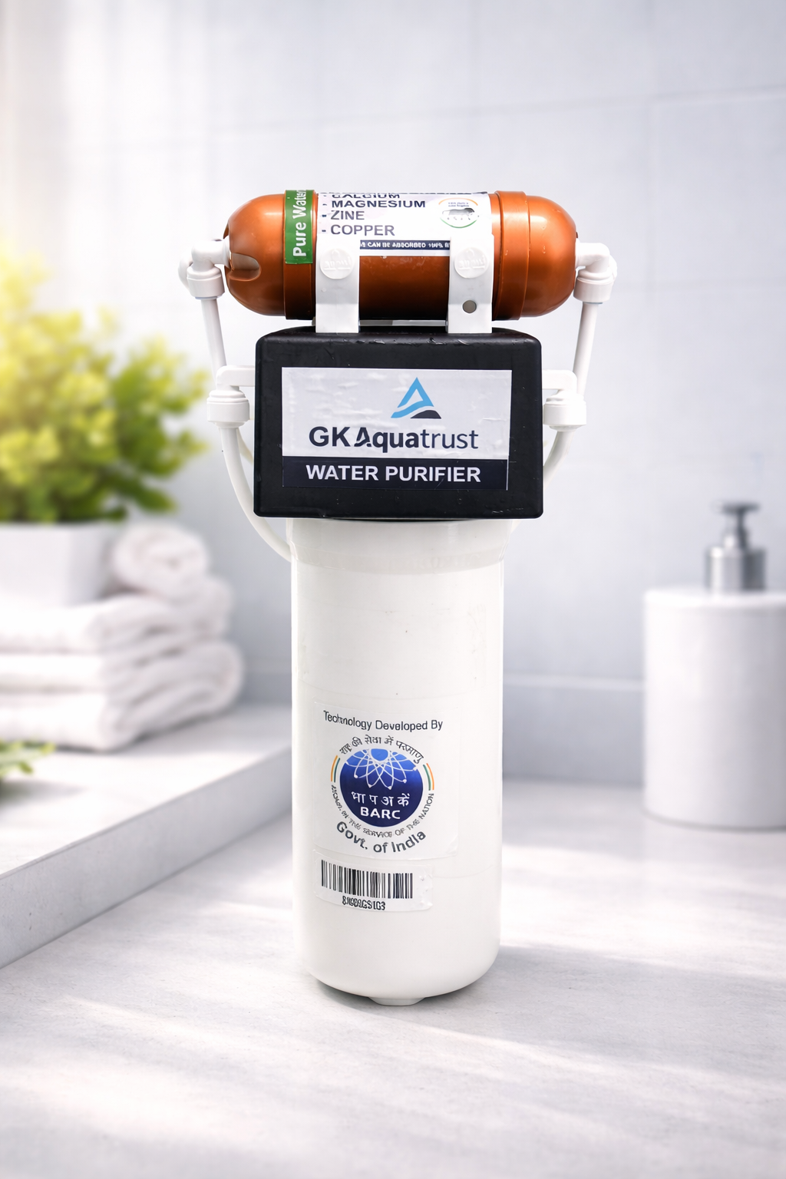
GK Aquatrust has 3 models
1. Two Stage Filtration water purifier
Cost INR 5000/ (Five thousands only)
Stage based on altera filtration membrane technology 0.01 micron
No electricity required
Self maintenance, low maintenance
Alkaline, antioxidant, anti-bacteria.

Slide 7
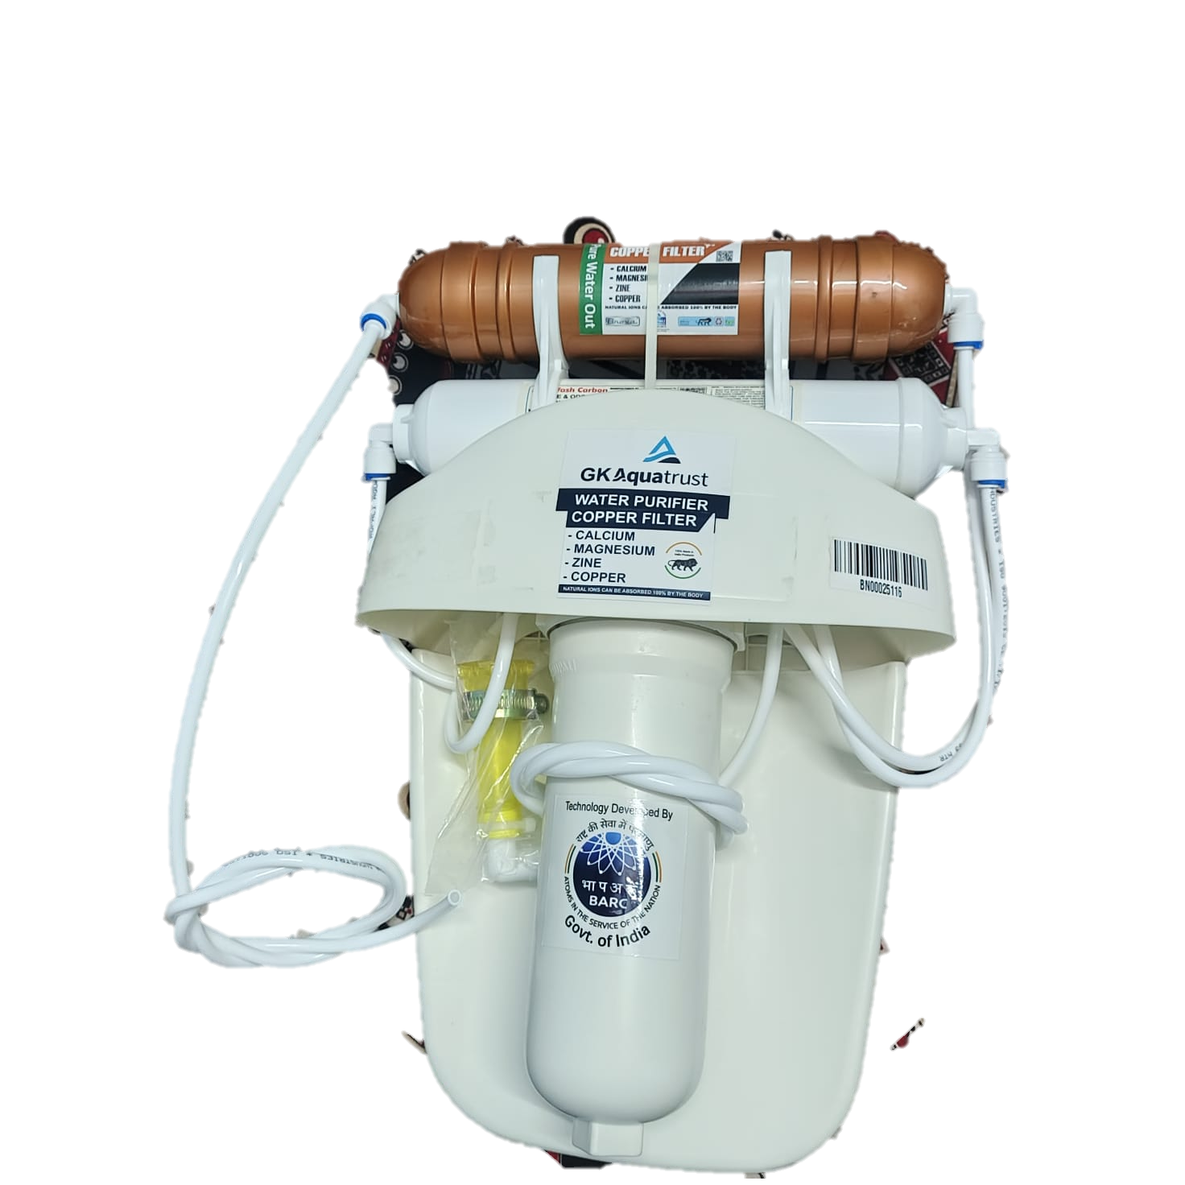
Second model
2. Three stage Filtration water Purifier.
Cost INR 6,000/ (Six Thousands Only)
Stage based on altera filtration membrane technology 0.01 micron
No electricity required
Self maintenance, low maintenance
Alkaline, antioxidant, anti-bacteria.

Slide 8
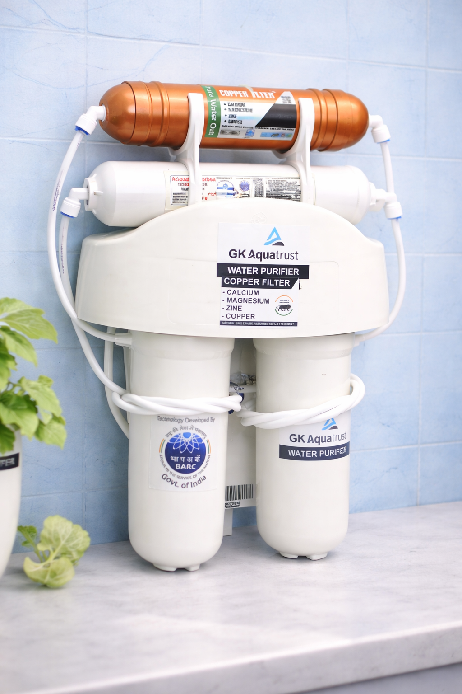
Third model
3. Four stage Filtration water Purifier.
Cost INR 7,000/ (Seven Thousands Only)
Stage based on altera filtration membrane technology 0.01 micron
No electricity required
Self maintenance, low maintenance
Alkaline, antioxidant, anti-bacteria.

Slide 9
Earnings
First Income : Direct sponsor Income 10%
Second Income: Matching Bonus 10%
Third Income: Handsome Rewards.
Royalty: After 15 level 2% of CTO
Pairing 1:1
Weekly Payout.
Capping weekly. 50,000, 60,000, 70,000 respectively

Slide 10
Business Opportunity
Work from home
Low investment
Unlimited income potential
Build your own team

Slide 11
Business Model
1. Join GK AquaTrust.
2. Sell the products
3. Add team members
4. Earn commission from team sales

Slide 12
Example Income Structure
Joining with product cost @7,000
Direct Sale Commission: 10%
Team Sale Bonus: 10% matching
. Payout weakly
Caping 70,000 weekly
Balance business carry forward

Slide 13
Rewards
Sr. No.Fortuner | Pair | Time | Reward
1. | 25 | 15 days | 4,000 Cash(Next)
2. | 50 | 30 days | 10,000 TrainingTour Manali (Next)
3. | 100 | 45 days | 20,000 Smart mob Phone(Next)
4. | 250 | 60 days | 50,000 Bangkok Tour 2D3N (Next)
5. | 500 | 90 days | 1,00,000 E- scooty (Next)
6. | 1000 | 120 days | 2,00,000 E-Bike (Next)
7. | 2000 | 150 days | 4,00,000 Paris Tour(Next)
8. | 5000 | 190 days | 10,00,000 EV Car(Next)
9. | 10,000 | 220 days | 20,00,000 Thar (Next)
10. | 25,000 | 240 days | 50,00,000 Fortuner (Next)
11. | 50,000 | 365 days | 1,00,00,000 Villa 100 sq yd

Slide 14
Why Join Us
Growing demand for water purifiers
Training and support
Flexible work
Build long‑term income

Slide 15
TERMS
The company reserve the right to change the price of product without any notification to distributors..
TDS @ 5% will be charged
GST as per govt norms will be charged extra
Admin charges @5%
Courier Charges @200/product

Slide 16
Our Vision
Safe drinking water for every home
Financial growth for every partner

Slide 17
Join Us Today
Start your journey now!
Contact: 9599326310

